Slide 1

Member : Le Ngoc Luc
Le Minh Chien
Thieu Chi Kien
Bui Van Dao
Luong Minh Khang

Slide 2
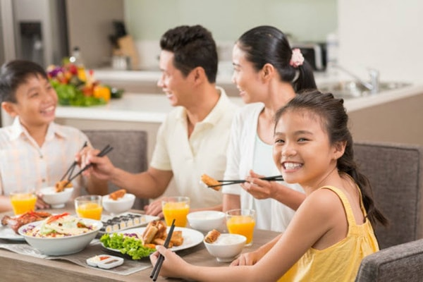
1.About Us
We are a young company, FLAVORS, born of a modern and affordable kitchen. We carry in our DNA the creativity, joy, and entrepreneurial spirit. More than a seasoning brand, FLAVORS is the main ingredient in an incredible story to share: a passion for food.

Slide 3
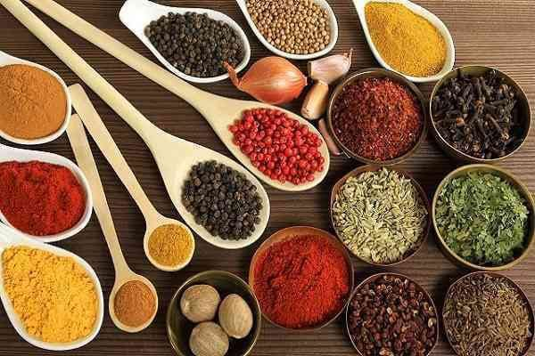
Our Spices
Good cooking for us is the creative cuisine. We built our product mix uniting aromas and flavors in a unique way, with all the knowledge. Creativity is in the right choices: working with non-industrialized ingredients, choosing long-time producers, and caring for a healthier life. We also combine unique flavors and blends to goals that go beyond a recipe, we want to break prejudices and translate the best traditions of the good table in a current and uncomplicated way.

Slide 4
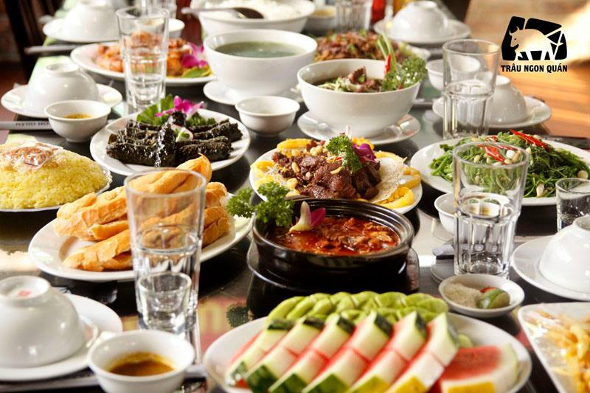
Our motto
FLAVORS rethinks how people and businesses relate to each other, and thickens a new gastronomic moment. We believe in the direct and attentive relationship with each client. We architect our products to value the best moments around the table. We are encouraging the culture of eating well and good cuisine. This is the motto that makes us wake up early every day.

Slide 5
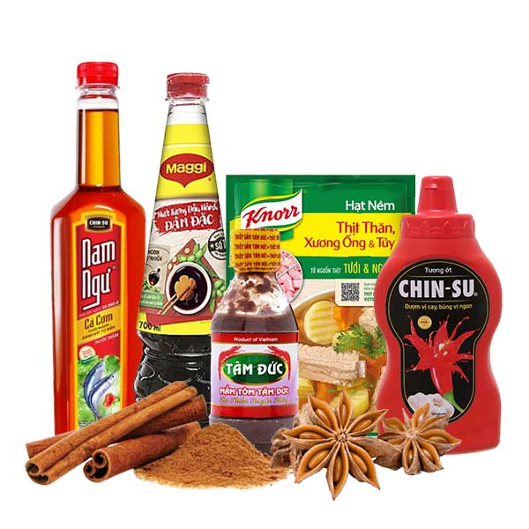
Our products
Company is involved in trading and manufacturing a wide range of Organic Products and spices to the consumers all around the global market. Company has wide variety of collection of products.

Slide 6

2. Project

Slide 7
What we are working on
Fontend
Backend
HTML5, CSS3, JAVASCRIPT
PHP, MySQL
Target
Testing
Customer and Admins
Loadstorm, Nessus

Slide 8
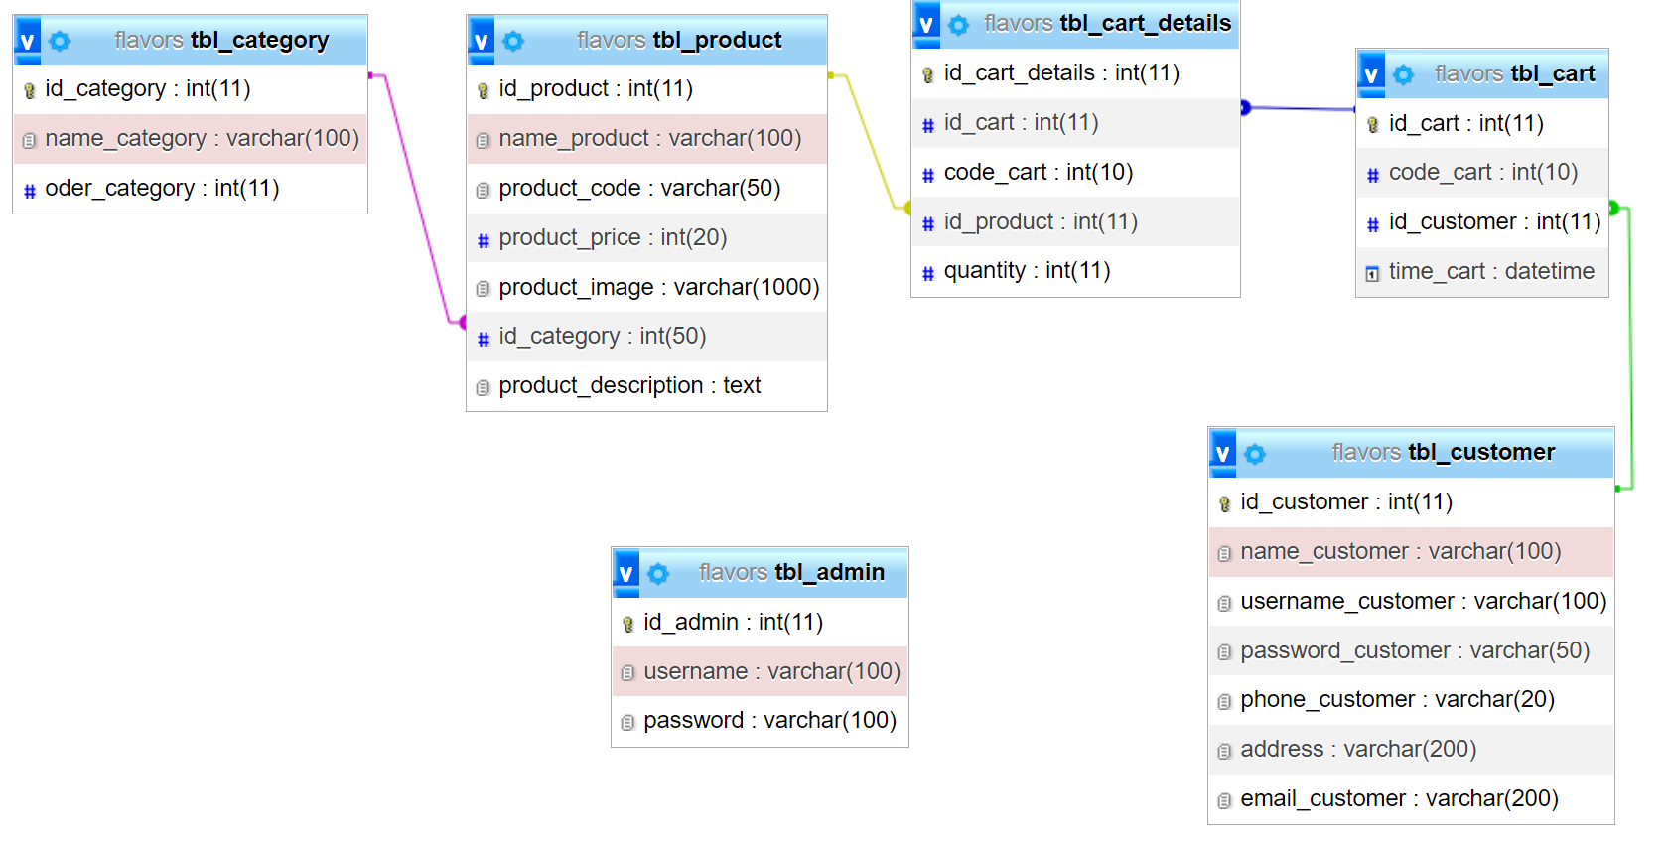
Database design

Slide 9
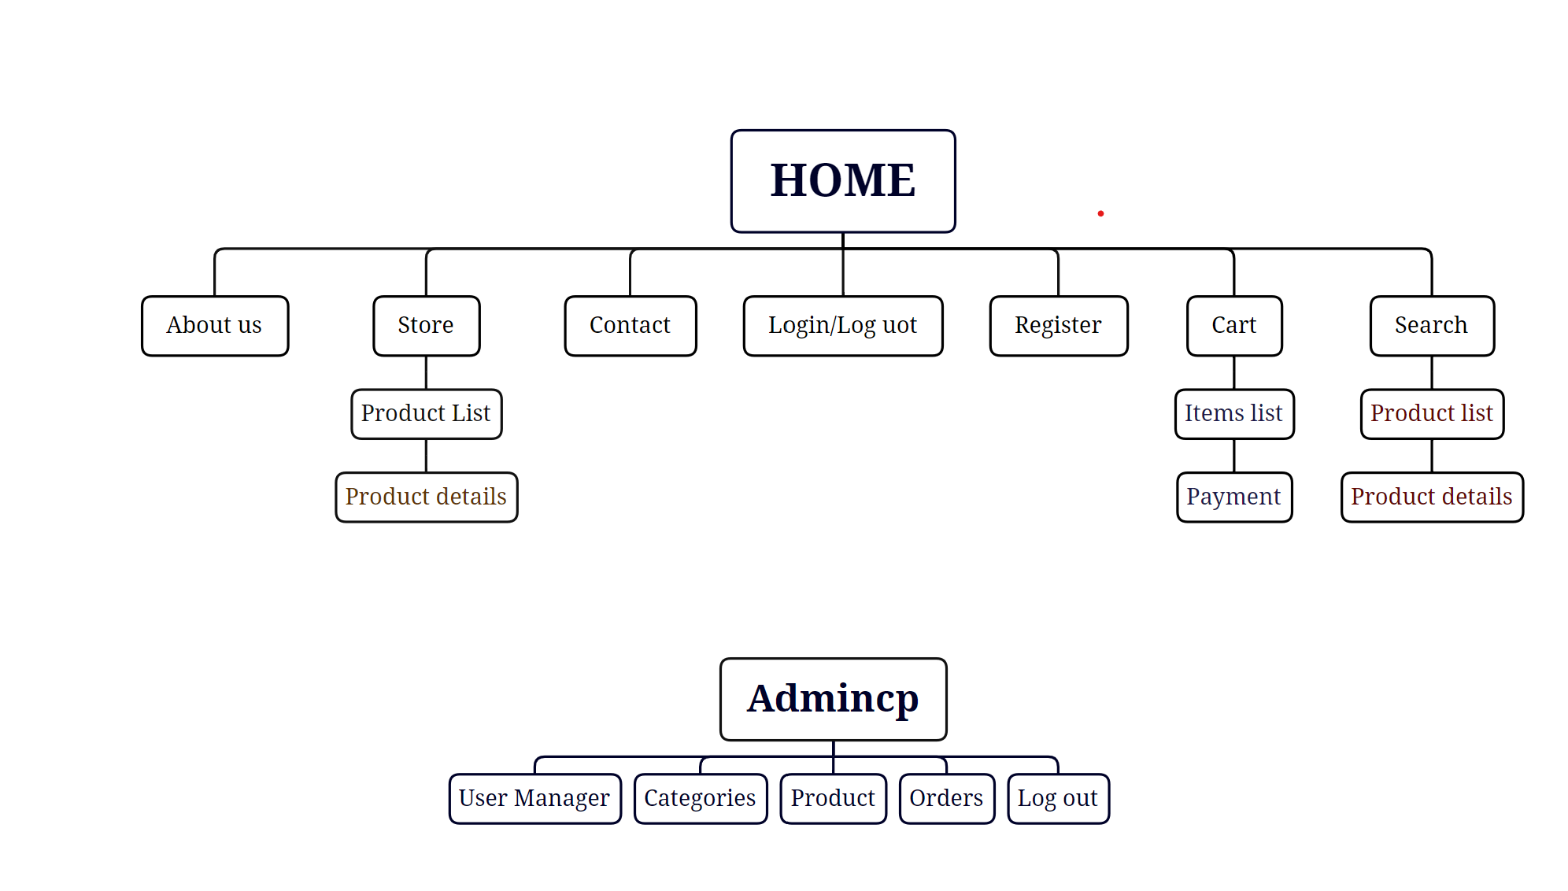
Site Map

Slide 10
THANK FOR WATCHING !

